Slide 1

D.Eco Application
Presented by Code Monkey

Slide 2

Sprint 1 Transition
Application Demo
Acceptance testing
Design Choices
Plan for Sprint 2
Code Monkey
April 5, 2017

Slide 3
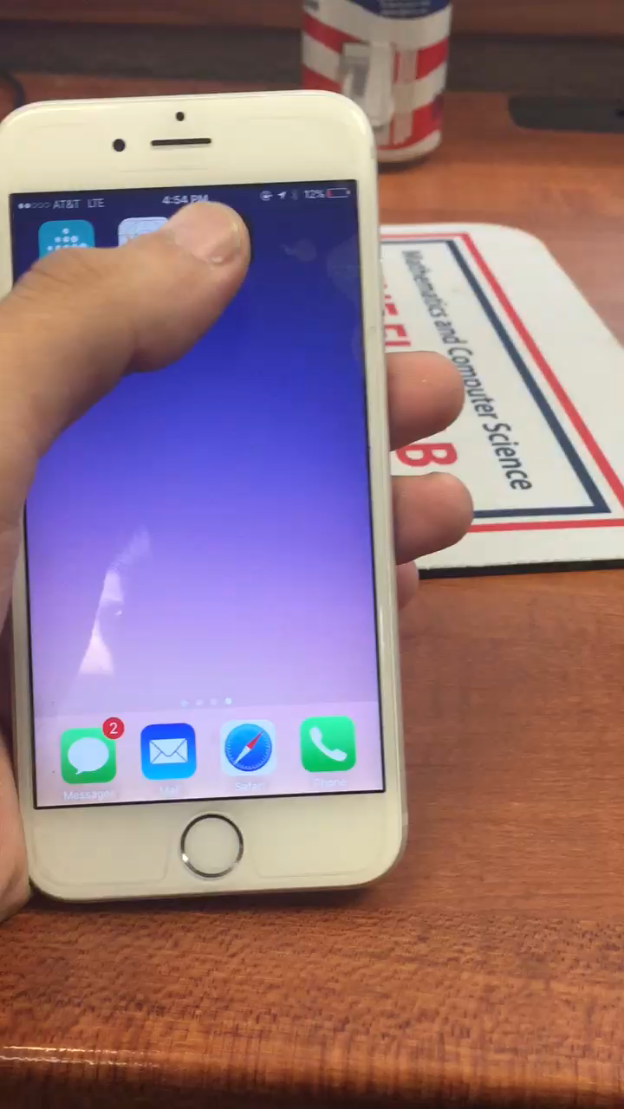
Demonstration
Code Monkey
May 4, 2017

Slide 4
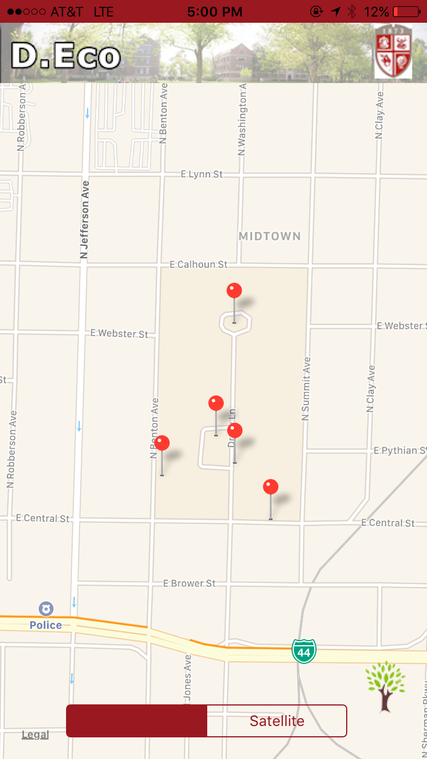
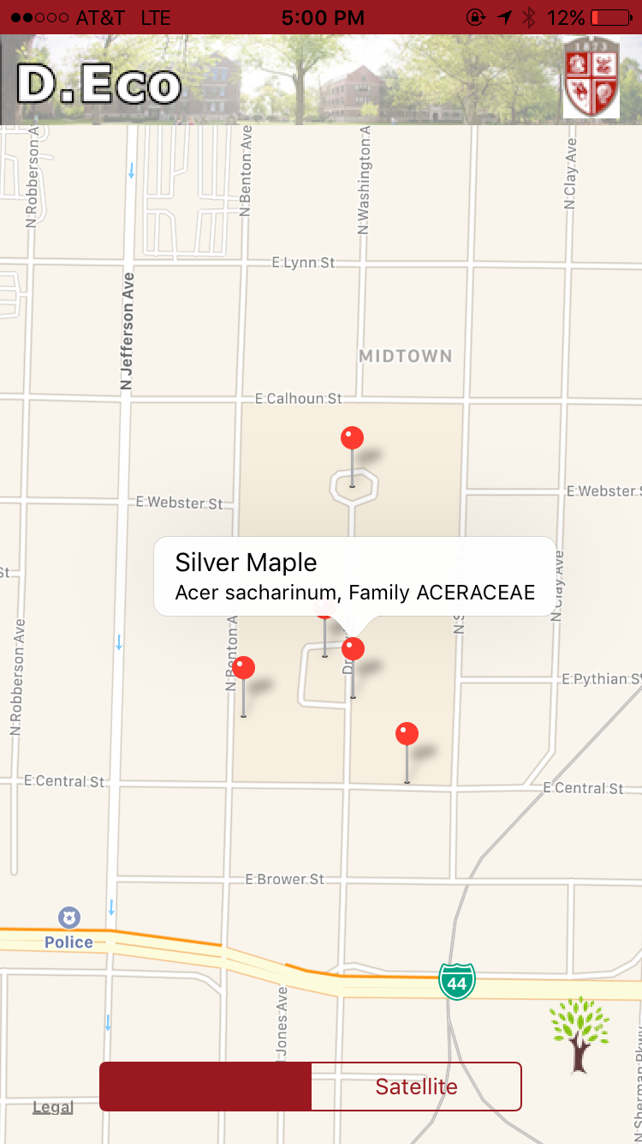
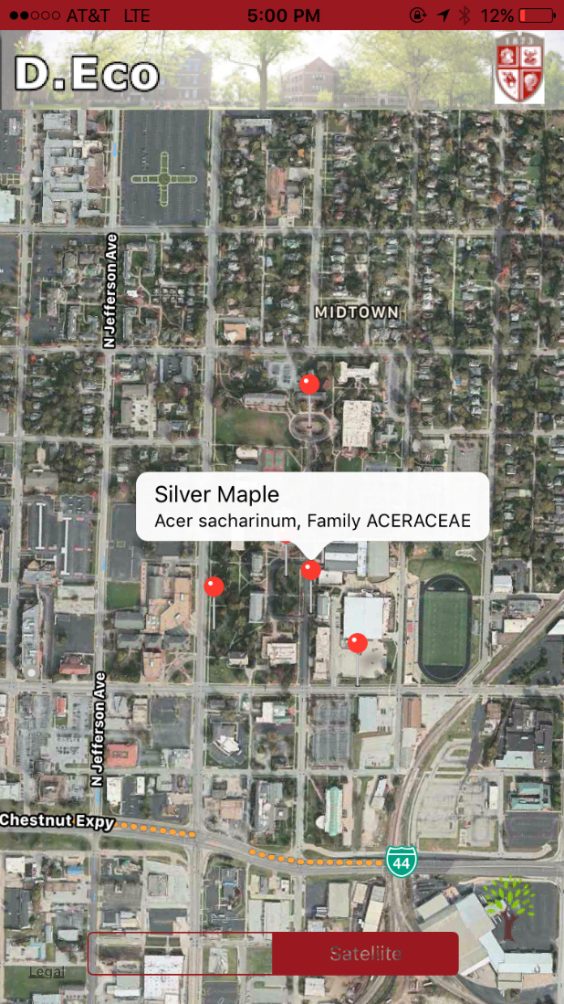
Demonstration
Code Monkey
May 4, 2017

Slide 5
Acceptance Testing
Test Description | Pass? (Yes/No)
Code Monkey
May 4, 2017

Slide 6
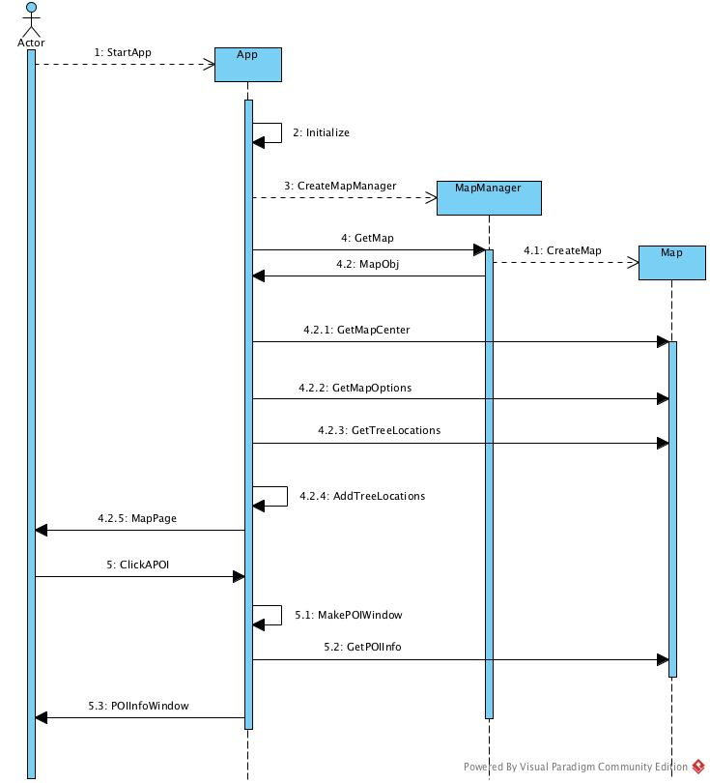
Design Choices
Single build – iOS
No external data – hard-coded data
Basic nodes
No GPS

Slide 7
What’s Next? – Sprint 2
At least 1 tour (21 tree tour?)
Database implementation
GPS User location/route
Menu/Search

Slide 8
Plan – Sprint 2
What | Who | When
Requirements (Update Use Case) | -- | --
Analysis (Update cost, risk & effort estimate) | -- | --
Design (Platforms & Architecture) | -- | --

